Slide 1
Loan Defaulter Prediction and Customer Segmentation
Siddhant Kashyap
Kailas S Warrier
Nikhil Mayaral
Hari Prakash G

Slide 2





AGENDA
01
02
03
04
05
06
Introduction
E D A
Data
Preprocessing
Balancing
Techniques
Modeling
&
Customer
Segmentation
Scopes

Slide 3
Introduction
Distribution of the loans is the core business part of almost every banks
The main portions of the bank’s assets directly come from profit earned from the loans distributed by the banks
Prime’s objective in the banking environment is to invest its assets in safe hands.
After approving loans, after regressing the progress of verification, there is no surety of repayment.
Hence industries need automation in these areas to reduce cost and time.

Slide 4
Problem Statement
Motive here is to build a credit risk score for affordable home loan applicants and help in approving or declining customer applicants.
Hence the model should provide a probability score that gives the likelihood that the applicant will default lf approved.
The data is related to the demographics and loan history of the masked customers from XYZ bank who have applied for the HNKS scheme.

Slide 5
Minimum 1 lakh
Affordable Interest rate - 7%+
Benefits of
HNKS
scheme
Combined income >8000
Select your Ideal Home.
Focus on Tier2 and Tier3 cities

Slide 6
Features
Demog Variables
Bureau Variables
Dummy_application_id ever60_24m_StrictFlag NATURE_OF_ORGANISATION
OCCUPATION_TYPE
Max_dependent
LTV
Doc_form_16 income_max income_sum income_min
edu_max
edu_min
age_max
age_min
cnt_coapplicant
REQUESTED_TENURE PROPERTY_INSURANCE_AMT
Organization_type
SALARIED_SELF CHANNEL_CODE
City_tier
FOIR2
Loan_sub_type_1
SAL_FLAG emi_income_max
emi_income_sum
All_No_of_TL
All_open_TL All_Vin_bureau All_min_Vin_bureau All_Delq_TL_24_M No_of_enq_All
Latest_Bureau_prd Bureau_TL

Slide 7
BASIC FILTERING OF DATA
ORGINAL
DATA
DROPPED UNNAMED, FOIR2 AND APPLICATION ID.
DROPPED ROWS HAVING INCOME_SUM<8000
DROPPED ROWS HAVING EMI_INCOME_SUM < 1
UPDATED DATA
(13154 * 32)
(13409 * 35)

Slide 8
Data preprocessing
TREATING
NULL
VALUES
DERIVING
FEATURES
SKEWNESS
CORRECTION
OUTLIER
TREATMENT
FEATURE
ENGINEERING
FEATURE SELECTION

Slide 9
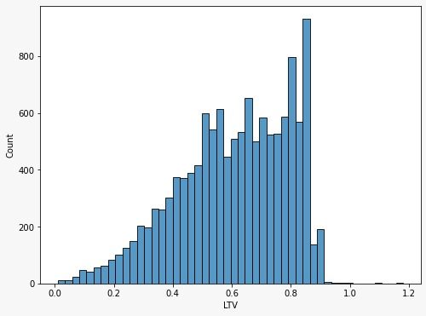
TREATING OF NULL VALUES
LTV having 416 null values and is left-skewed and hence median imputation can be done.
Nature of organisation and occupation type containing null values has been dropped because contains simplified columns to replace.

Slide 10
DERIVED
FEATURES
EMI PAID
(emi_income_sum * income_sum)
Amount Left
(Income_sum – emi)
Eligible amount
Property amount
Eligible amount / LTV
Revenue Generated
amount_left * requested tenure *12

Slide 11
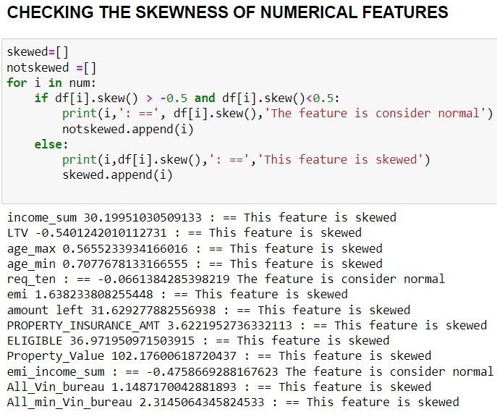
SKEWNESS CORRECTION & OUTLIER TREATMENT

Slide 12


log10 transformation applied
Skew reduced from 30 to 1.4
Outliers reduced from 967 to 410
Removed outlier and feature became normal
OUTLIER TREATMENT
INCOME SUM
Median imputation to the outliers
LTV > 1 removed
L T V
Log transformation applied and skew reduced from 0.71 to 0.75
Z Score method applied to remove the outliers
age_min
Similar treatment as age_min
age_max
Z score method applied to remove outliers
emi_income_sum
Z score method applied to remove outliers
Requested tenure

Slide 13
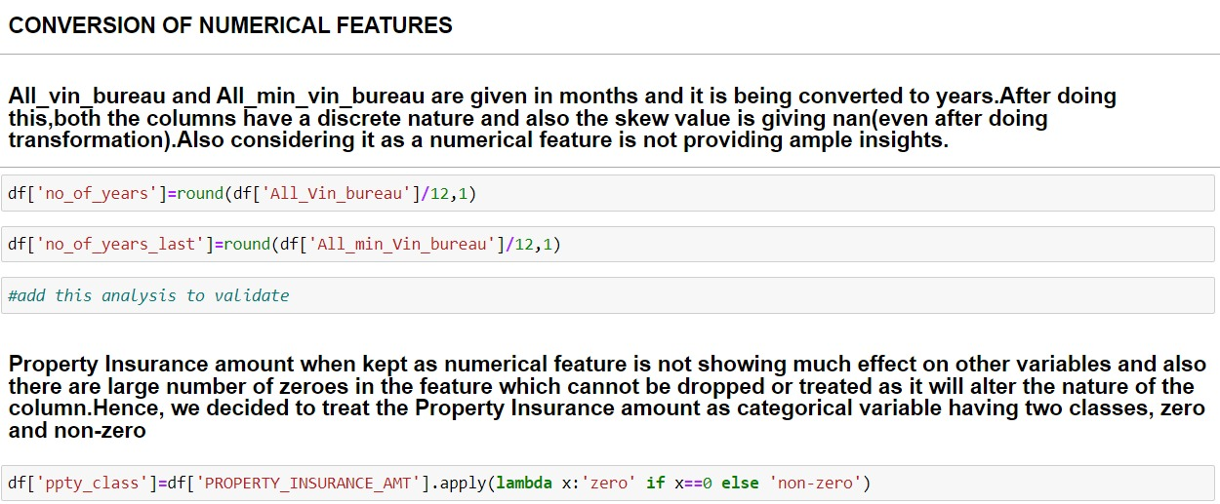
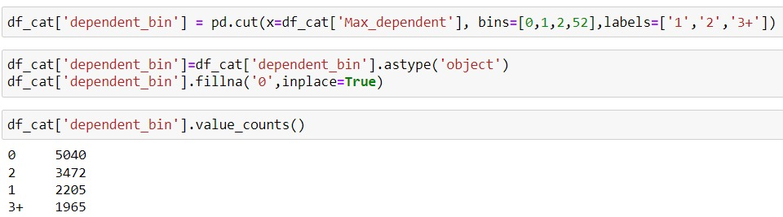
FEATURE ENGINEERING
Conversion of numerical to categorical

Slide 14
FEATURE ENGINEERING
Categorical variables
ORGINAL VARIABLES | CONVERTED VARIABLES
NO_OF_ENQ_ALL | ENQ BIN [0,2,4,10,151]
ALL_DELQ_TL_24_M | NO OFF DELQ ZERO and NON ZERO
NO OF YEARS | YEARS BIN 0,2,4,7,10,37
NO OF YEARS LAST | YEARS OF LAST BIN 0,1,2,3,5,25

Slide 15
FEATURE ENGINEERING
Categorical variables
ORIGINAL VARIABLES | CONVERTED VARIABLES
ALL_NO_OF_TL | NO OF LOANS [1,4,8,304]
ALL OPEN TL | NO OF ACTIVE LOANS [0,1,2,4,159]
CNT COAPPLICANT | CNT COAPPLICANT 0,1
CHANNEL CODE | CHANNEL CODE 0,1,2,3

Slide 16
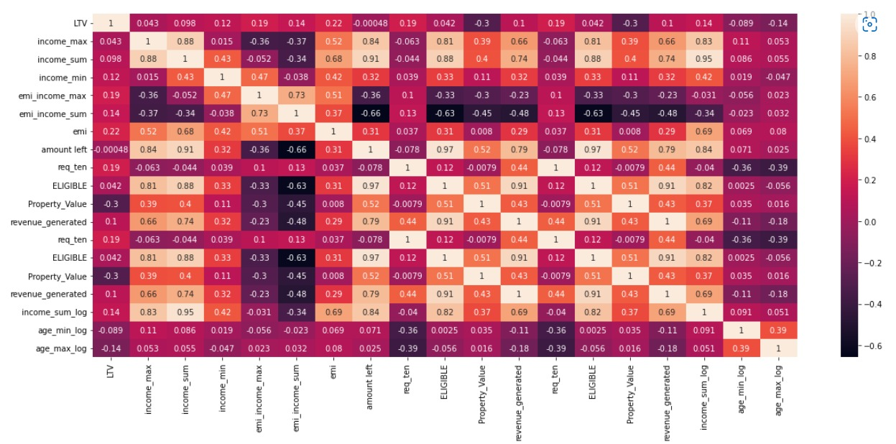
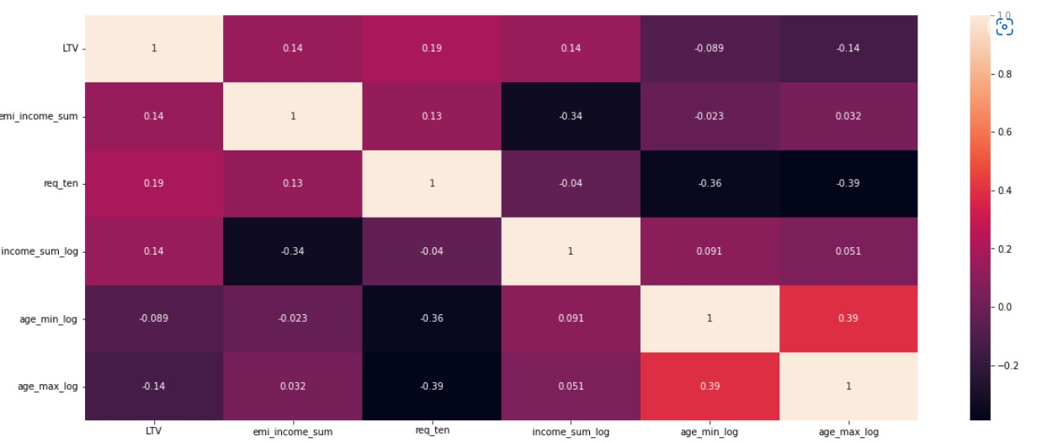
FEATURE SELECTION

Slide 17
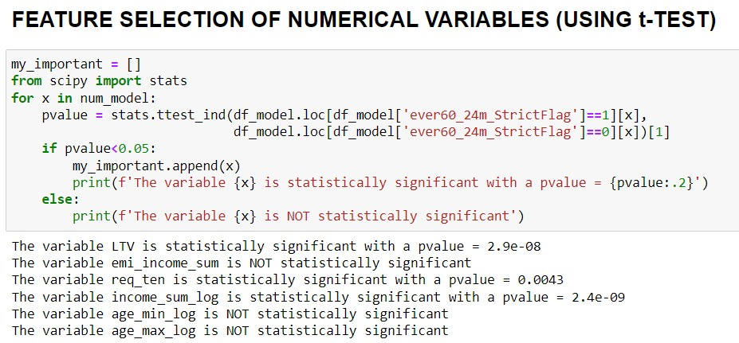
FEATURE SELECTION OF NUMERICAL VARIABLES

Slide 18
FEATURE SELECTION OF NUMERICAL VARIABLES

Slide 19
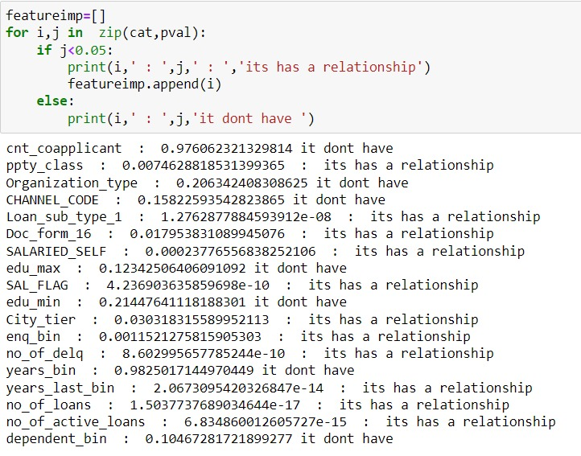
FEATURE SELECTION OF CATEGORICAL VARIABLES

Slide 20
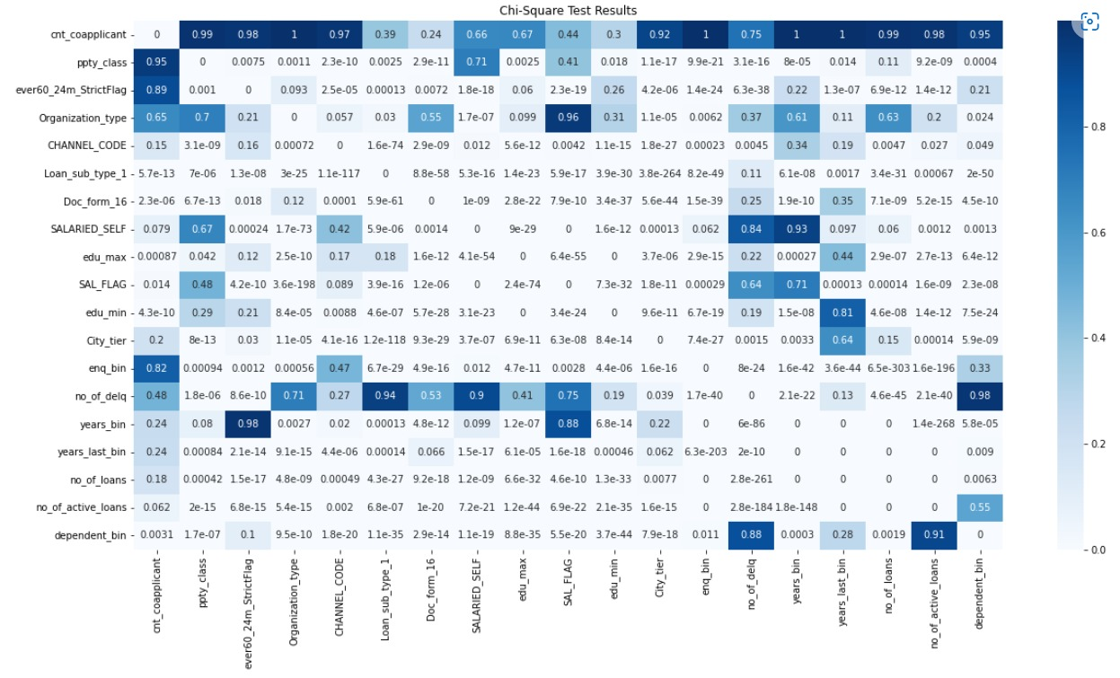
FEATURE SELECTION OF CATEGORICAL VARIABLES

Slide 21
MODELLING RESULTS AND COMPARISON ( WITH IMBALANCE)
ALGORITHM | RECALL | PRECISION | F1-SCORE
LOGISTIC REGRESSION (2342 , 195) | 0 – 1.00 1 -0.00 | 0- 0.92 1-0.00 | 0-0.96 1-0.00
SVC | 0- 1.00 1- 0.00 | 0- 0.92 1- 1.00 | 0- 0.96 1- 0.00
RANDOM FOREST | 0- 1.00 1- 0.00 | 0- 0.92 1- 0.00 | 0- 0.96 1- 0.00
LOGISTIC REGRESSION (USING CLASS WEIGHTS) | 0- 0.64 1- 0.52 | 0- 0.94 1- 0.11 | 0- 0.77 1- 0.18
SVC (USING CLASS WEIGHTS) | 0- 0.66 1- 0.53 | 0- 0.94 1- 0.12 | 0- 0.78 1- 0.19
RANDOM FOREST (USING CLASS WEIGHTS) | 0- 1.00 1- 0.00 | 0- 0.92 1- 0.00 | 0- 0.96 1- 0.00

Slide 22
MODELLING RESULTS AND COMPARISON (USING SMOTE)
ALGORITHM | RECALL | PRECISION | F1-SCORE
XGB CLASSIFIER (2353 , 2358) | 0 – 0.89 1 -0.92 | 0- 0.92 1- 0.89 | 0- 0.90 1- 0.90
LOGISTIC REGRESSION | 0- 0.75 1- 0.74 | 0- 0.72 1- 0.71 | 0- 0.74 1- 0.72
RANDOM FOREST | 0- 0.91 1- 0.94 | 0- 0.94 1- 0.91 | 0- 0.92 1- 0.93

Slide 23
SCOPE
MORE HYPER PARAMETER TUNING
LOG ODDS
RATIO INTERPRETATION
PLATT SCALING IN SVC
DIFFERENT SMOTE VARIETIES
6
THRESHOLD
IMBALANCING USING GMEANS
4
CUMILATIVE ACCURACY PROFILING
2
5
1
3

Slide 24
THANK YOU

